Slide 1
Decision Tree and Random Forest

Slide 2
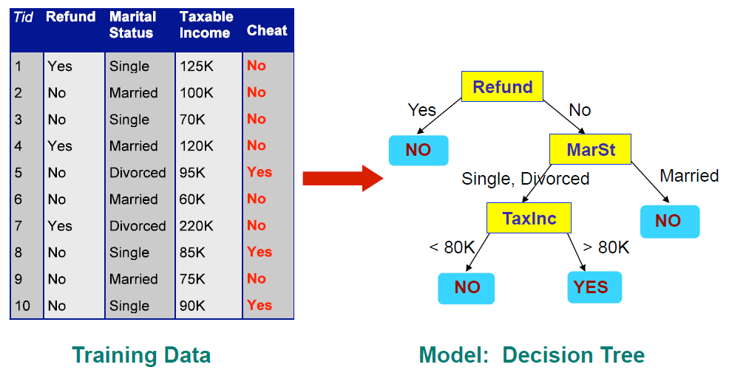
Decision Tree
Has a flowchart/tree-like representation
Each node represents a test on columns of data
Each branch represents an outcome of the node’s test
Terminal/leaf nodes decide the predicted labels of the instances
Can be applied to both classification and regression

Slide 3
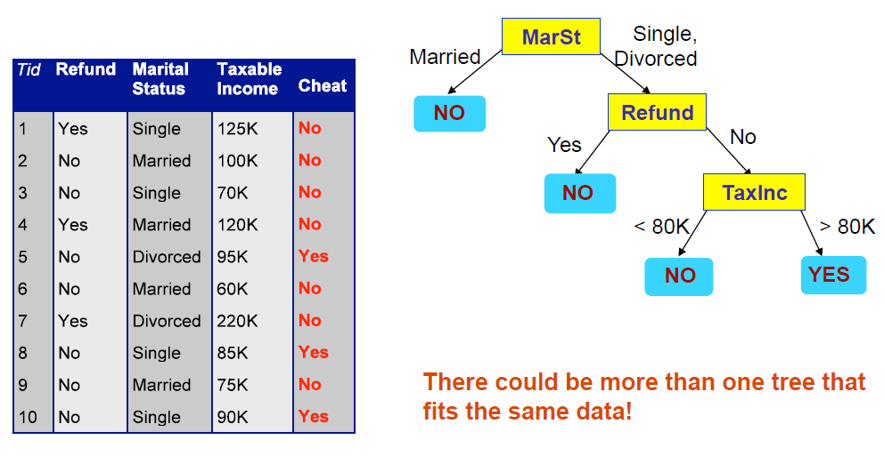
Another Example of Decision Tree

Slide 4
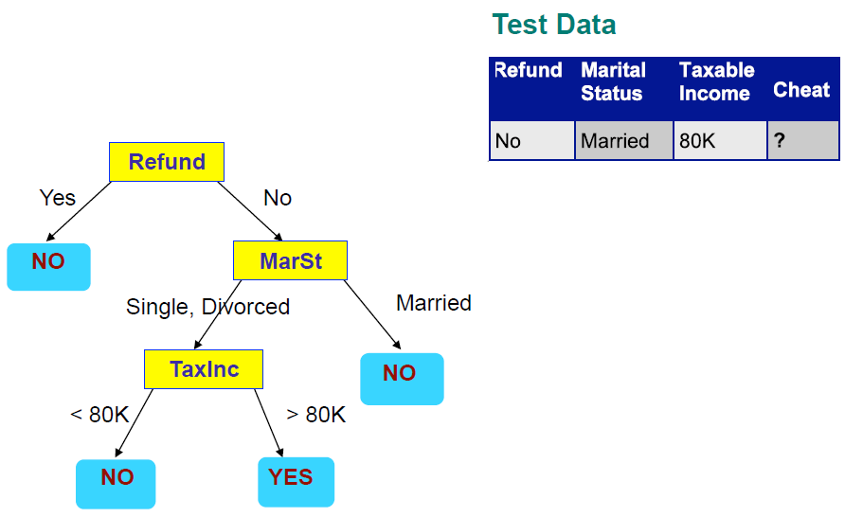
Applying a Tree to Test Data
Start from the Root Node

Slide 5
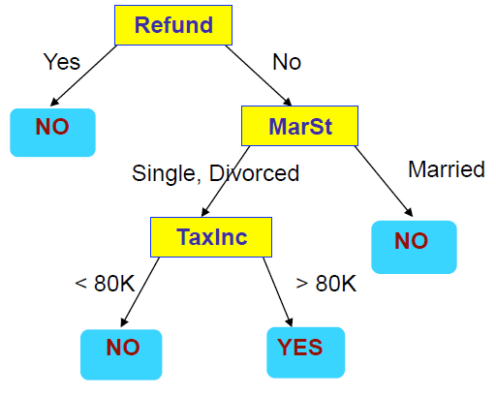
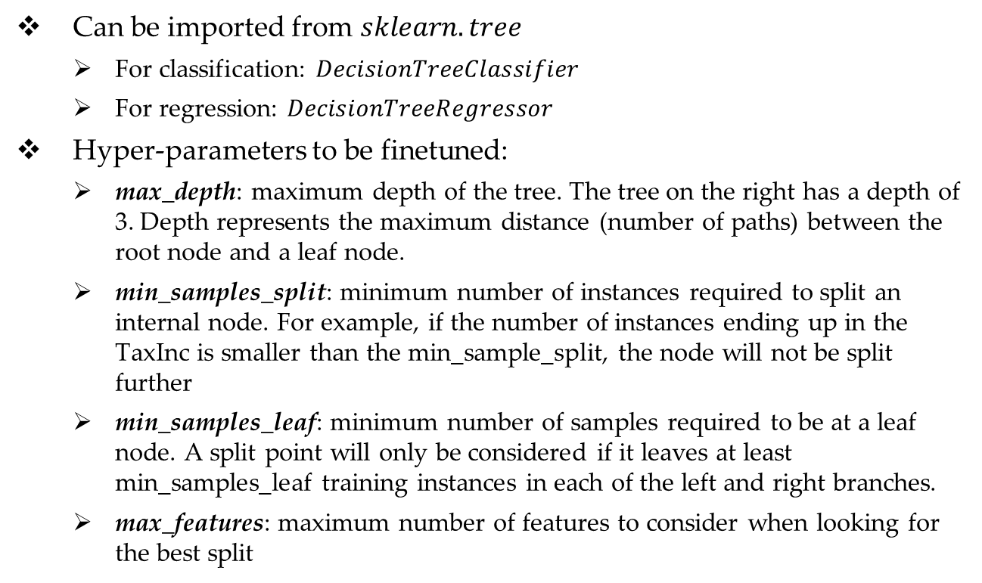
Decision Tree in SKLearn
Can be imported from $sklearn.tree$
For classification: $DecisionTreeClassifier$
For regression: $DecisionTreeRegressor$
Hyper-parameters to be finetuned:
max_depth: maximum depth of the tree. The tree on the right has a depth of 3. Depth represents the maximum distance (number of paths) between the root node and a leaf node.
min_samples_split: minimum number of instances required to split an internal node. For example, if the number of instances ending up in the TaxInc is smaller than the min_sample_split, the node will not be split further
min_samples_leaf: minimum number of samples required to be at a leaf node. A split point will only be considered if it leaves at least min_samples_leaf training instances in each of the left and right branches.
max_features: maximum number of features to consider when looking for the best split

Slide 6
Advantages and Disadvantages of Decision Tree
Advantages | Disadvantages
Nonparametric approach Inexpensive to construct Extremely fast at classifying unknown records Easy to interpret for small-sized trees Accuracy is comparable to other classification techniques for many simple data sets Robust to the presence of noise The presence of redundant attributes does not adversely affect the accuracy of decision trees | Can easily overfit if not finetune properly Can be unstable because small variations in the data might result in a completely different tree being generated. Can be biased if some classes dominate. It is therefore recommended to balance the dataset prior to fitting with the decision tree.

Slide 7
Decision Tree for Regression
Decision tree can also be applied on regression problem. The leaf nodes will provide the prediction for the numeric target values instead of target class.
In SKLearn, we use DecisionTreeRegressor for regression tasks. All the hyperparameters stay the same as DecisionTreeClassifier

Slide 8
Random Forest
You may have guessed from the name, a Random Forest is an ensemble model that consists of multiple decision trees
Each tree is fit/trained using a random subset of the data (in terms of both instances and features)
The use of multiple trees
Stabilizes the model
Mitigates overfitting
Improve performances in general

Slide 9
Random Forest in SKLearn
We use RandomForestClassifier and RandomForestRegressor, both are from sklearn.ensemble
Has all hyper-parameters of decision tree, with an additional one:
n_estimators: number of trees to fit
Like SVM, Random Forest is also very powerful and is usually among the top-performed models

